Slide 1



Profibus/Profinet
Team : MD LIMON APU

Slide 2
AGENDA
INTRODUCTION TO PROFIBUS/ PROFINET.
PROFIBUS.
PROFINET.
APPLICATIONS.
SIMULATION.
CONCLUTION.

Slide 3
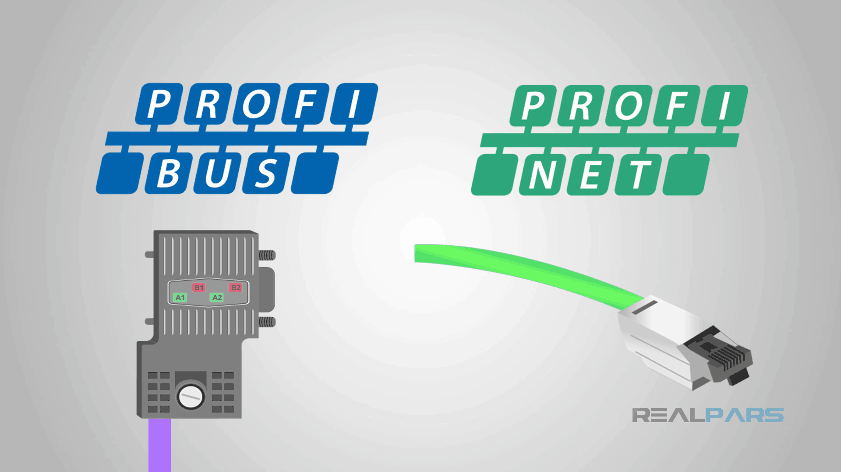
INTRODUCTION TO PROFIBUS/ PROFINET
PROFINET:
Advanced industrial Ethernet-based communication protocol.
Real-time data transfer and high-speed performance.
Seamless integration with existing systems.
PROFIBUS:
Established industrial communication standard.
Reliable and versatile fieldbus technology.
Enables seamless automation connectivity.

Slide 4
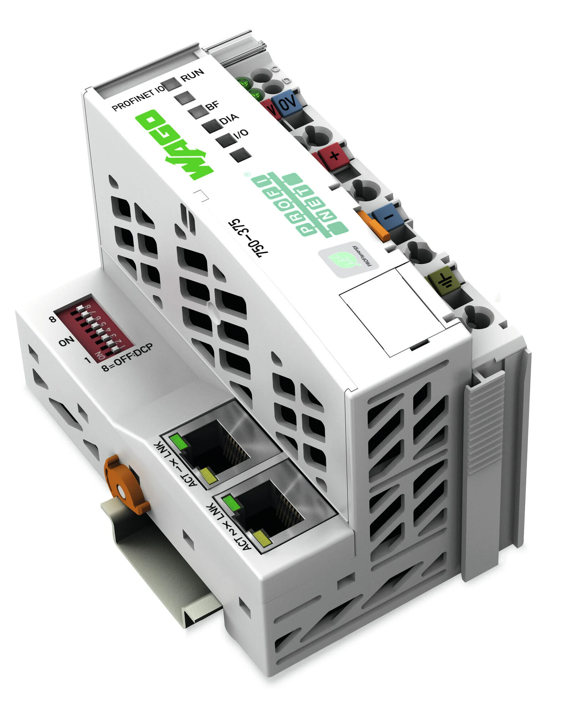
PROFINET
Ethernet-based communication protocol.
Developed by PROFIBUS & PROFINET International.
Real-time communication for industrial Automation.
Supports motion control, safety, energy management, and diagnostics.

Slide 5
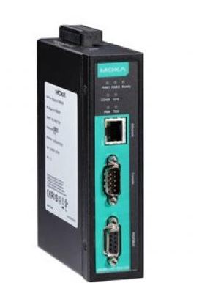
PROFIBUS
Fieldbus communication protocol.
Developed by PROFIBUS & PROFINET International.
Works for different topologies such as star.
Supports various device types, including sensors, actuators, controllers, and drives.

Slide 6
Architecture
PROFIBUS
PROFINET
Centralized controller (PLC) and decentralized peripherals.
PROFIBUS DP for factory automation.
PROFIBUS PA for process automation.
Controller acts as the master, peripherals as slaves.
Controller (PLC) and IO devices.
PROFINET IO for real-time communication.
PROFINET CBA for component-based automation.
Flexible and scalable architecture

Slide 7
DATA LAYERS
PROFIBUS
PROFINET
Physical Layer:
Based on RS-485(Slow speed).
Transmission rates 9.6 Kbps, 12 Mbps, and 45 Mbps.
Data Link Layer:
PROFIBUS DP and PROFIBUS PA protocol.
Provides error checking and correction
Physical Layer:
Use Ethernet Technology(High Speed).
Transmission rates 10 Mbps, 100 Mbps, and 1 Gbps.
Data Link Layer:
Ethernet II and IEEE 802.3 protocol.
Provide communication with a maximum cycle time of 31.25 µs.

Slide 8
COMMUNICATION REQUIREMENT
Bandwidth:
Profibus DP can handle up to 12 Mbit/s.
Profinet up to 100 Mbit/s.
Latency:
Profibus ranging from microseconds to milliseconds.
Profinet ranging from microseconds to low milliseconds.

Slide 9
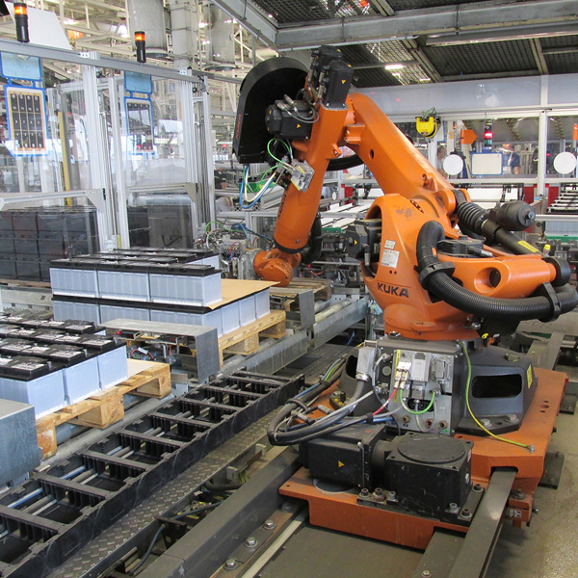
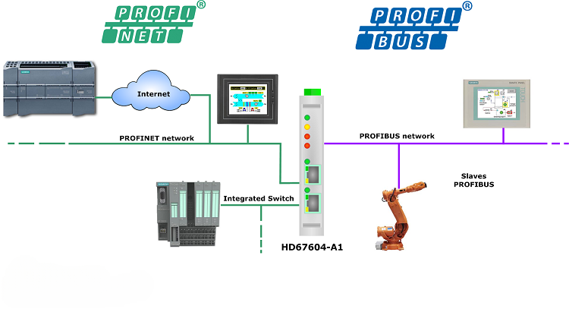
Applications
Manufacturing and Assembly Lines

Slide 10
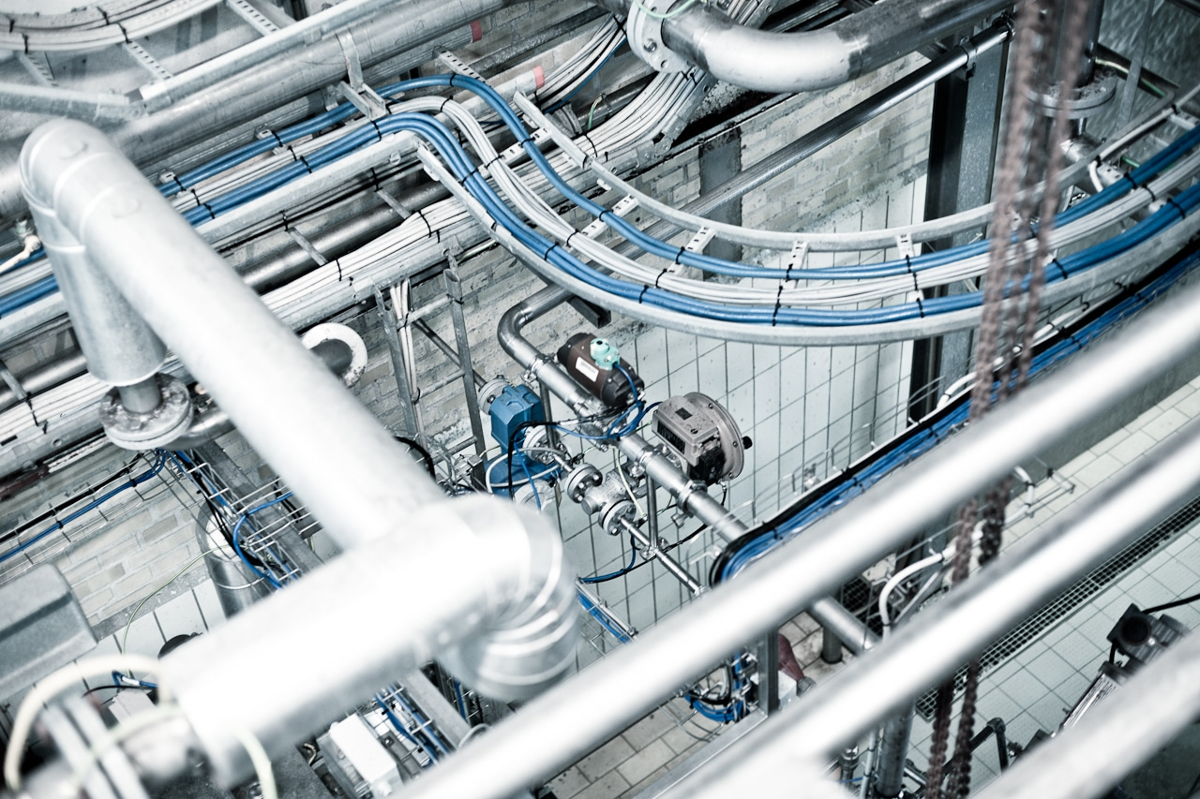
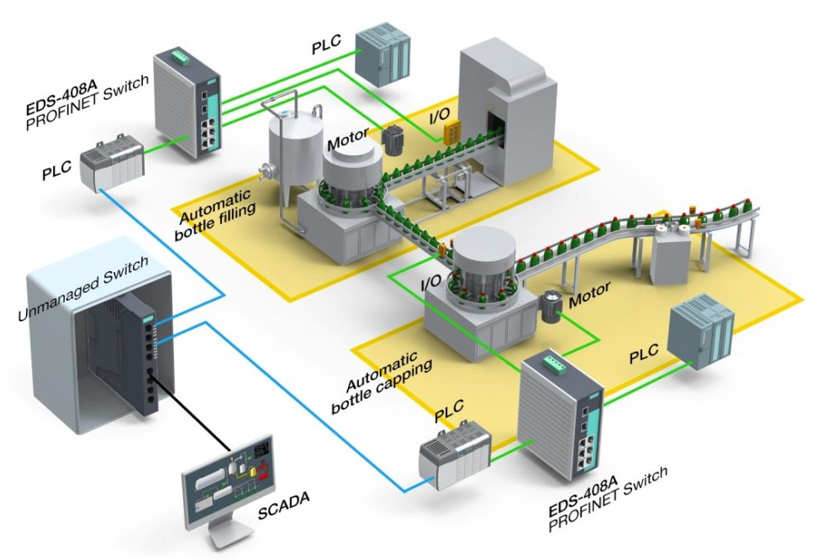
Applications
Bottling facilities

Slide 11
Pros & cons
PROFIBUS
PROFINET
Robust and Reliable Technology.
Cost-Effective Industrial Automation Solution.
Limited Bandwidth for Data Transmission.
Compatibility Challenges with Modern Systems.
High-Speed Real-Time Communication.
Seamless Ethernet Integration and Interoperability.
Complexity and Higher Setup Costs.
Vulnerability to Network Issues.

Slide 12
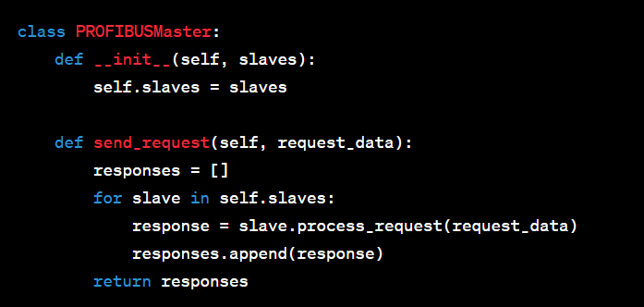

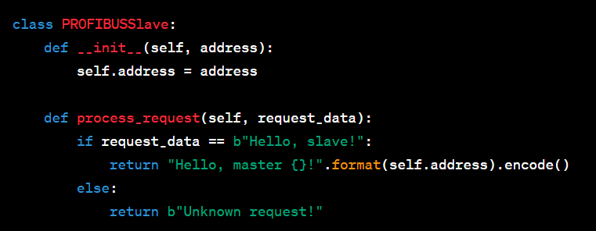
SIMULATION(PROFIBUS)

Slide 13
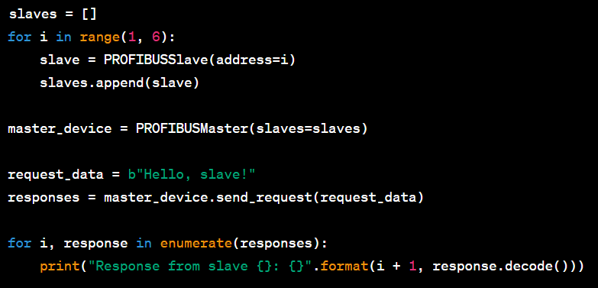
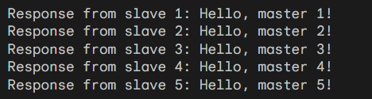
SIMULATION(PROFIBUS)
RESULTS

Slide 14


